Slide 1
Introduction to Statistical Learning
Tianhang Zheng
https://tianzheng4.github.io

Slide 2
Course Website
https://tianzheng4.github.io/umkc-teaching/2023-fall-teaching-1/
What are on the course website:
Lecture slides
Lab material
Contact Information
If you are interested in my research, feel free to contact me.

Slide 3
Assignments and Requirements
Course + Lab: Theory and Implementation 30%
Course Project: Maximum four people in one group 20%
Mid-term and Final Exams 20% + 30%

Slide 4
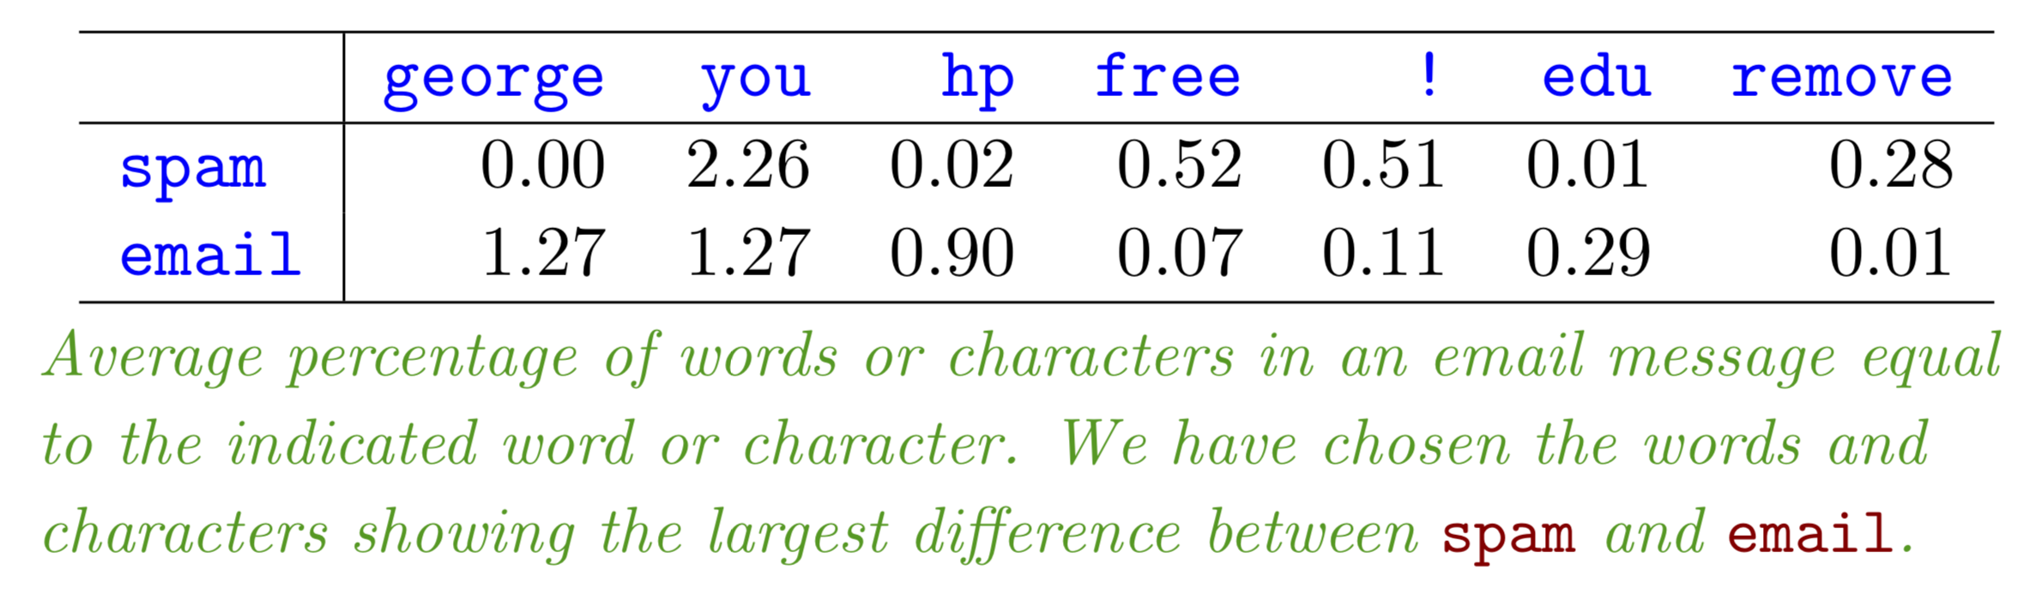
Learning Problems: Spam Detection
Given features of emails, build a spam filter

Slide 5
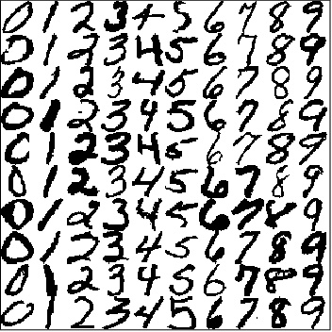
Handwritten Digit Recognition
Given the images of handwritten digits, recognize the digits
MNIST dataset
https://www.kaggle.com/datasets/hojjatk/mnist-dataset

Slide 6
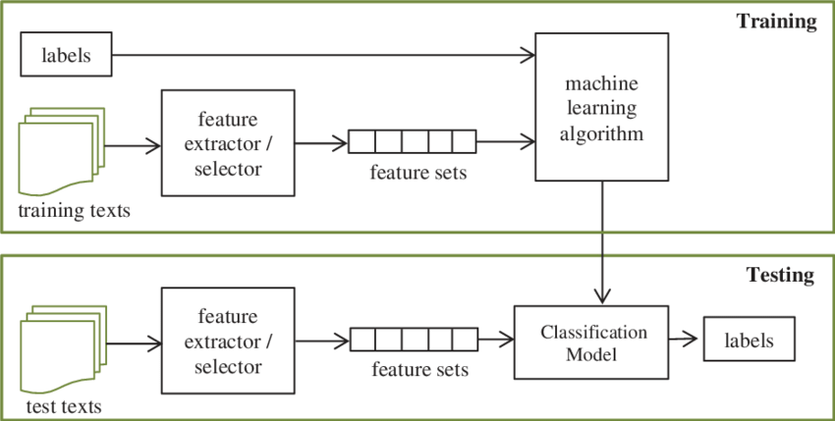
Text Classification

Slide 7
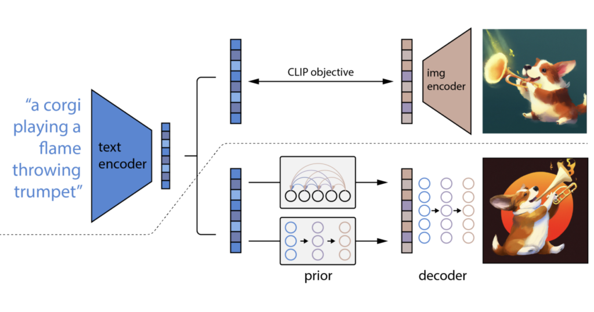
Text-to-Image Generation

Slide 8
Applications of Machine Learning
bioinformatics
detecting network intrusion
neuroscience
medical diagnosis
stock market analysis
social network analysis
traffic and infrastructure planning
…

Slide 9
Textbooks
An Introduction to Statistical Learning
Machine Learning with Python Tutorial (Optional)
https://tianzheng4.github.io/umkc-teaching/2023-fall-teaching-1/

Slide 10

What is Machine Learning?
Definition (First Try)
Machine learning is concerned with designing and developing algorithms that allow machines to learn.
machines? computers? to learn?
need to quantify "learning"
to improve their performance over time
Definition (Second Try)
Machine learning is concerned with the design and development of algorithms that allow computers (machines) to improve their performance over time.

Slide 11
What is Machine Learning?
What is the source of the improved performance?
New insights by the algorithm designer?
Definition (Final version)
Machine learning is concerned with designing and developing algorithms that allow computers (machines) to improve their performance over time based on data.
Definition (Mitchell, 1998)
A computer program is said to learn from experience E with respect to some class of tasks T and performance measure P, if its performance at tasks in T, as measured by P, improves with experience E.

Slide 12
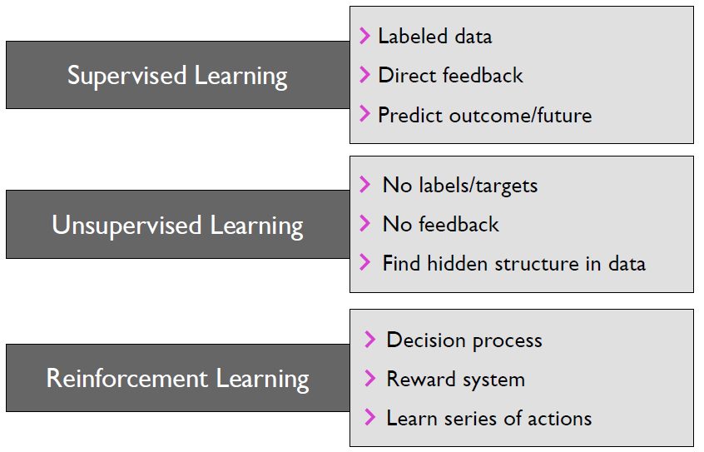
Categories of Machine Learning

Slide 13
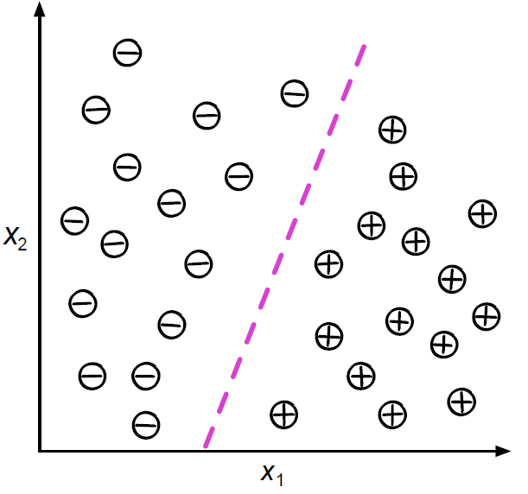
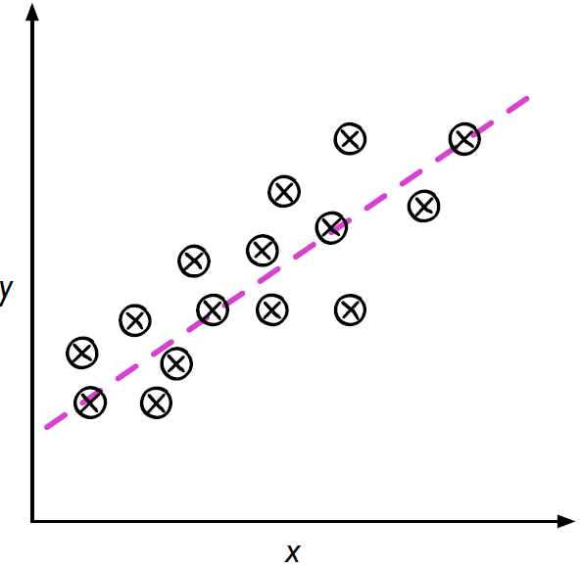
Categories of Machine Learning
Supervised learning
Supervised learning is the subcategory of machine learning that focuses on learning a classification, or regression model, that is, learning from labeled training data.

Slide 14
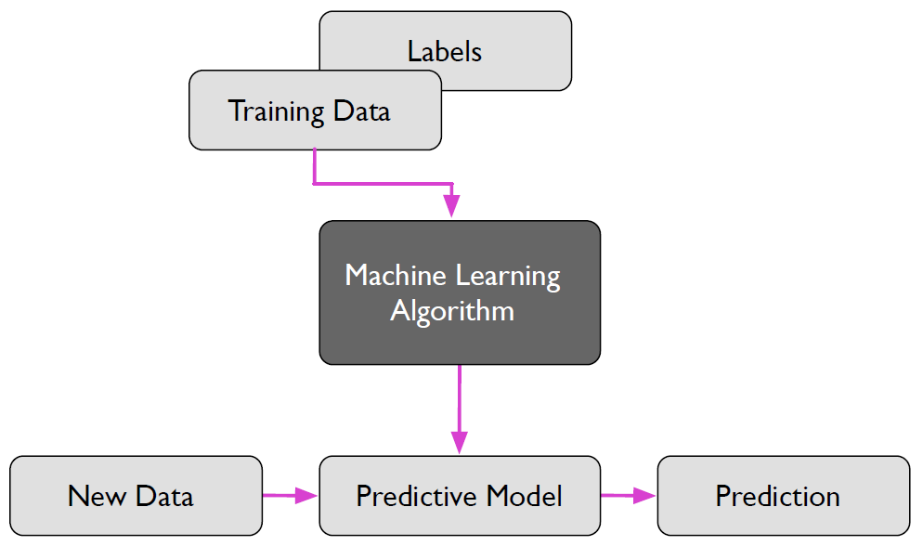
Categories of Machine Learning
Supervised learning
A rough overview of the supervised learning process.

Slide 15
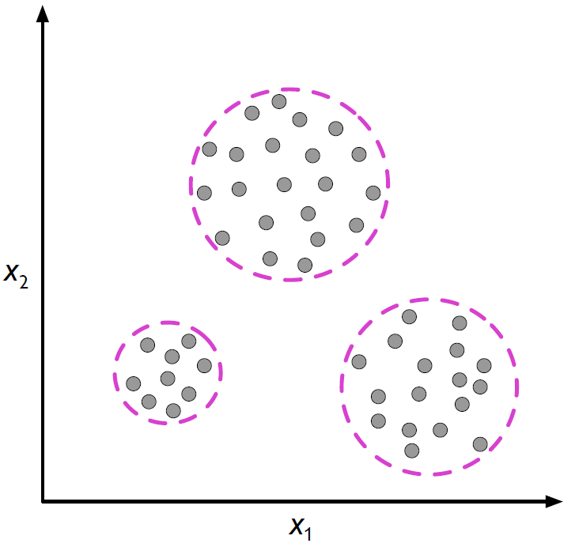
Categories of Machine Learning
Unsupervised learning
Unsupervised learning is a branch of machine learning that is concerned with unlabeled data. Common tasks in unsupervised learning are clustering analysis and dimensionality reduction.

Slide 16
Categories of Machine Learning
Semi-supervised learning
Loosely speaking, semi-supervised learning can be described as a mix of supervised and unsupervised learning.
In semi-supervised learning tasks, some training examples contain outputs, but some do not.
We then use the labeled training subset to label the unlabeled portion of the training set, which we then also utilize for model training.

Slide 17
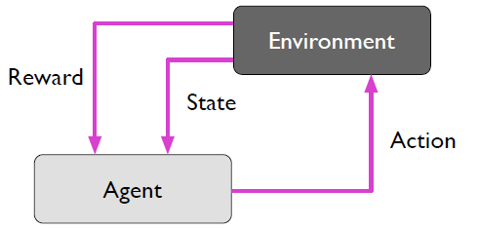
Categories of Machine Learning
Reinforcement learning
Reinforcement learning is the process of learning from rewards while performing a series of actions.
In reinforcement learning, we do not tell the learner or agent (for example, a robot), which action to take but merely assign a reward to each action and/or the overall outcome.
Instead of having “correct/false” labels for each step, the learner must discover or learn behavior that maximizes the reward for a series of actions. In that sense, it is not a supervised setting.
Notes:
Example: Game playing. There is one reward at the end of the game (negative or positive).
Find suitable actions in a given environment with the goal of maximizing some reward.
correct input/output pairs never presented Reward might only come after many actions.
Current action may not only influence the current reward, but future rewards too.

Slide 18


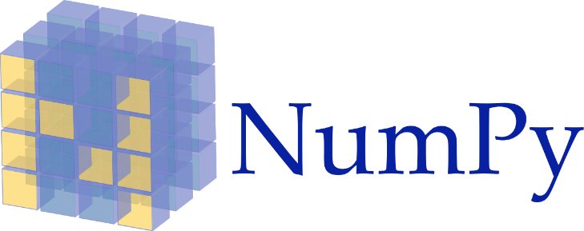



Tools

Slide 19
Python Resources
Kaggle: https://www.kaggle.com/learn/python
Learn Python: https://www.learnpython.org/
Python for Beginners by Microsoft: https://learn.microsoft.com/en-us/shows/intro-to-python-development/
Python for Everybody (up to 6 hours): https://www.youtube.com/watch?v=8DvywoWv6fI
Google it

